Slide 1
Developing Data Value Analytics of a Relational Database for an Online Retailer
Nihar Sudhanshu Limaye
Student Number :- 18210876
Email :- nihar.limaye3@mail.dcu.ie
Supervisor:
Dr. Rob Brennan
Email : rob.brennan@dcu.ie
28th Aug 2019

Slide 2
Project Motivation
Huge data volume
Data management has a cost
Need way to prioritize datasets
Data value can identify useful data for a business
Few quantitative methods for assessing data value
No method to assess data value in relational database (RDB)
Notes:
Lots of data volume due to introduction of multimedia, social media etc.
To manage such huge kind of data costs is high and it will affect the most to small org.
Some method of governance must be present to prioritize data so less imp data can be removed, churned or improved.
Data value is the type of governance which can solve data management issues and rank data.
Less tools, methods and state of art present today to measure data value most of them I will discuss in literature section.
As per my knowledge there is no method which finds value in a relational data source.

Slide 3
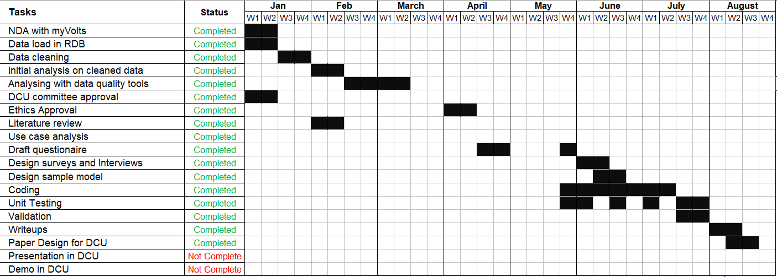
Project Timeline
Notes:
I worked throughout the sem from Jan till Aug. Starting from NDA,Ethics approval, to Demo in DCU.

Slide 4
Need of Data value
Why we need data value analytics in the real world?
More data available but less technique to decide valuable data
Solve issues occur in data migration or data backup activity
Prioritize the dataset and save manual efforts finding data value.
How Data value typically addressed?
A manual approach using surveys and interviews
May cause error due to the absence of technical process
Improvement
Use of automated approach besides with surveys and interviews
Notes:
More data less technique hence most of imp resource are wasted managing unnecessary data.
Solution
It will solve issues which occurs in data migration or data backup so they will prioritize the data and priority will be given first to them.

Slide 5
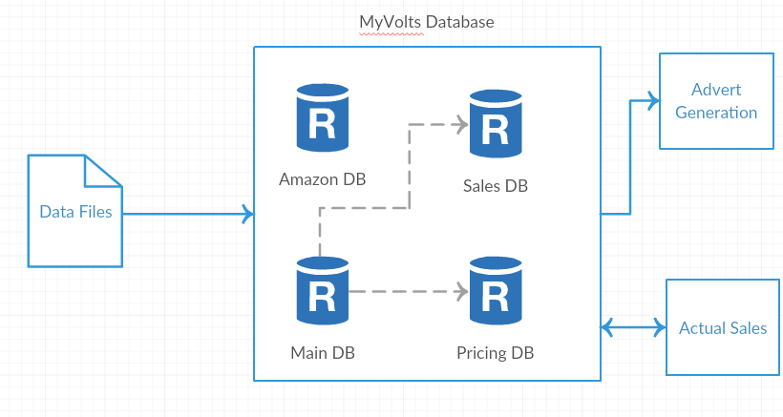
Use Case
Why MyVolts considered for this research?
MyVolts collects data from web to generate ads.
Multiple datasets used with high volume
SME hence data storage is important factor
Evaluation needed to manage crucial data
Fig 1. MyVolts DB structure
Notes:
It is a company with small size and located in Dublin. They make and sell electric appliances like adapters, modem etc.
They have their own website plus they sell their electric products on amazon hence deal with lots of data.
It’s a startup hence they can’t manage such huge data so some kind of data management is essential.
They were needed some technique which decides the importance of data hence decision can be taken on data storage.
This research will help them in the evaluation of crucial data.
Single use case only taken as this research is 1st only.

Slide 6
Dataset
Data acquisition from MyVolts
Uses MySQL database
Amazon dataset
Biggest database of MyVolts
Data consists of amazon listed products of MyVolts
Pricing dataset
Dynamic pricing depending on sales
Can be lowered or high price
Sales dataset
MyVolts own website data
Contains sensitive data
Notes:
Signed NDA with MyVolts to get a data. They gave 3 sql file which is a snapshot of their huge database.
The 3 sql files represented 3 databases namely Amazon, Pricing and Sales. They asked us to prioritize the dataset within themselves using data value technique so that they can arrange proper resource to important database.
Amazon – Biggest database consists of power supply name, price, 4 amazon price etc.
Pricing- Dynamic data of price they make price high or low depending upon sale of particular item.
Sales – Own website data with actual sale value and customer data.

Slide 7
Research Questions
1. To what extent can the value of a relational database (RDB) of an organization be accurately measured using a metrics-based approach?
2. Which predefined data value metrics are most useful for predicting the value for the MyVolts use case?
3. Which specifically tailored metrics will add the most to the characterization of data value in the MyVolts use case?
Notes:
Meaning whether metric based technique can be useful to find data value?
If yes, which specific dimension/metrics can be used from literature?
And which new metric/dimension I have to create which are not covered in literature?

Slide 8
Introduction
What are Dimensions?
Category designed while considering user oriented views towards data for finding a data value
Eg. Usage - > More used more valuable
Security -> More secured more valuable
What are Metrics?
Subcategory of Dimension
Multiple metrics can be added under one dimensions
Eg: Volume -> Record count, Interconnection
Notes:
Dimensions?
It is a category designed while considering the user views regarding a data. Like usage is a dimension which say like if some thing is more used it’s imp. Same concept is taken in finding dv.
Metric?
It can be multiple and expresses dimension broadly. Eg Usage -> More writes or more reads on DB in a single day if this happens then database is imp.
How historically it was addressed?
Designed questions basis dimensions and asked to domain experts. No automated approach taken under consideration. Data value might be wrong as no technical approach to back it.

Slide 9
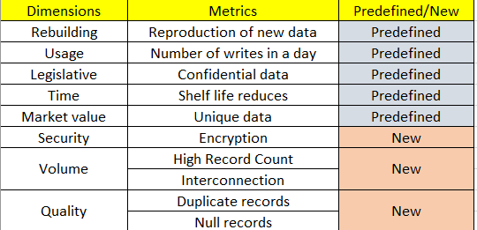
Dimensions & Metrics
Fig 2. Dimensions & Metrics
Notes:
Explain one or two dimension like:
Volume- More volume more important
Security- If data is more secured it must be important.
Eg. A,b,c datasets using 8 dimension my tool can say which dataset is more valued.

Slide 10
Literature Review
Reference | Paper explains | Improvements
Brennan et al. [3] | To evaluate data governance value-driven methods are useful | 1. Just an introduction to Data governance and data value 2. No methods proposed for finding DV
Moody et al. [4] | Use of "Laws of information" for finding DV | Considered surveys, interviews to find DV, which was good but No technical approach to back it
Brennan et al. [9] | Capability Maturity Model (CMM) that tries to identify specific metrics but uses open data to analyze it | Use of metrics for assessing DV but uses open data
Sajko et al. [2] | Gives an idea of dimensions and their corresponding metrics to be used for value assessment | Fewer dimensions & metrics taken to measure data value so I have added more in the project to get better results.
Notes:
Paper written by my supervisor but gave only idea and importance of data value. No method to find it.
Used laws of info like one laws says more connection with other data more imp or more accurate more imp but no method to back it just theoretical analysis.
Used open data but no method.
Introduced data value assessment by dimension and metrics but failed to explain tech background.

Slide 11
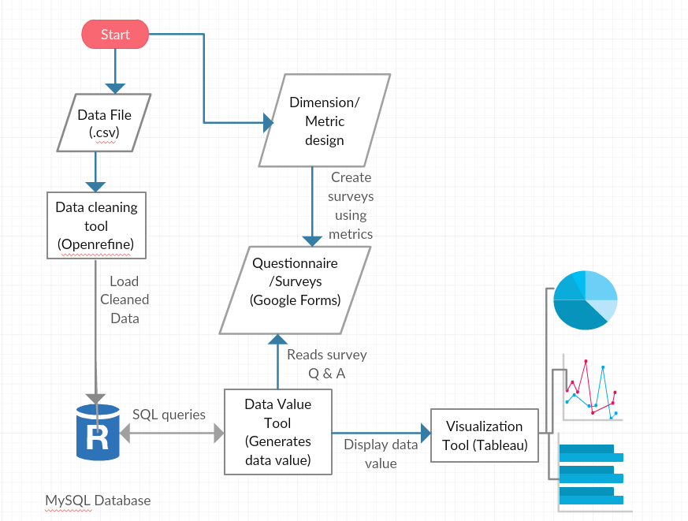
Design of a System
Fig 3. Blocks of System
Notes:
Data cleaning tool only used to handle reporting errors.
Why Relational DB only? as MyVolts uses fredo DB which is a RDB.
I took survey regarding data value and asked questions to domain experts of MyVolts.
3. MySQL, Python and tableau works well with together hence that trio used in this project.

Slide 12
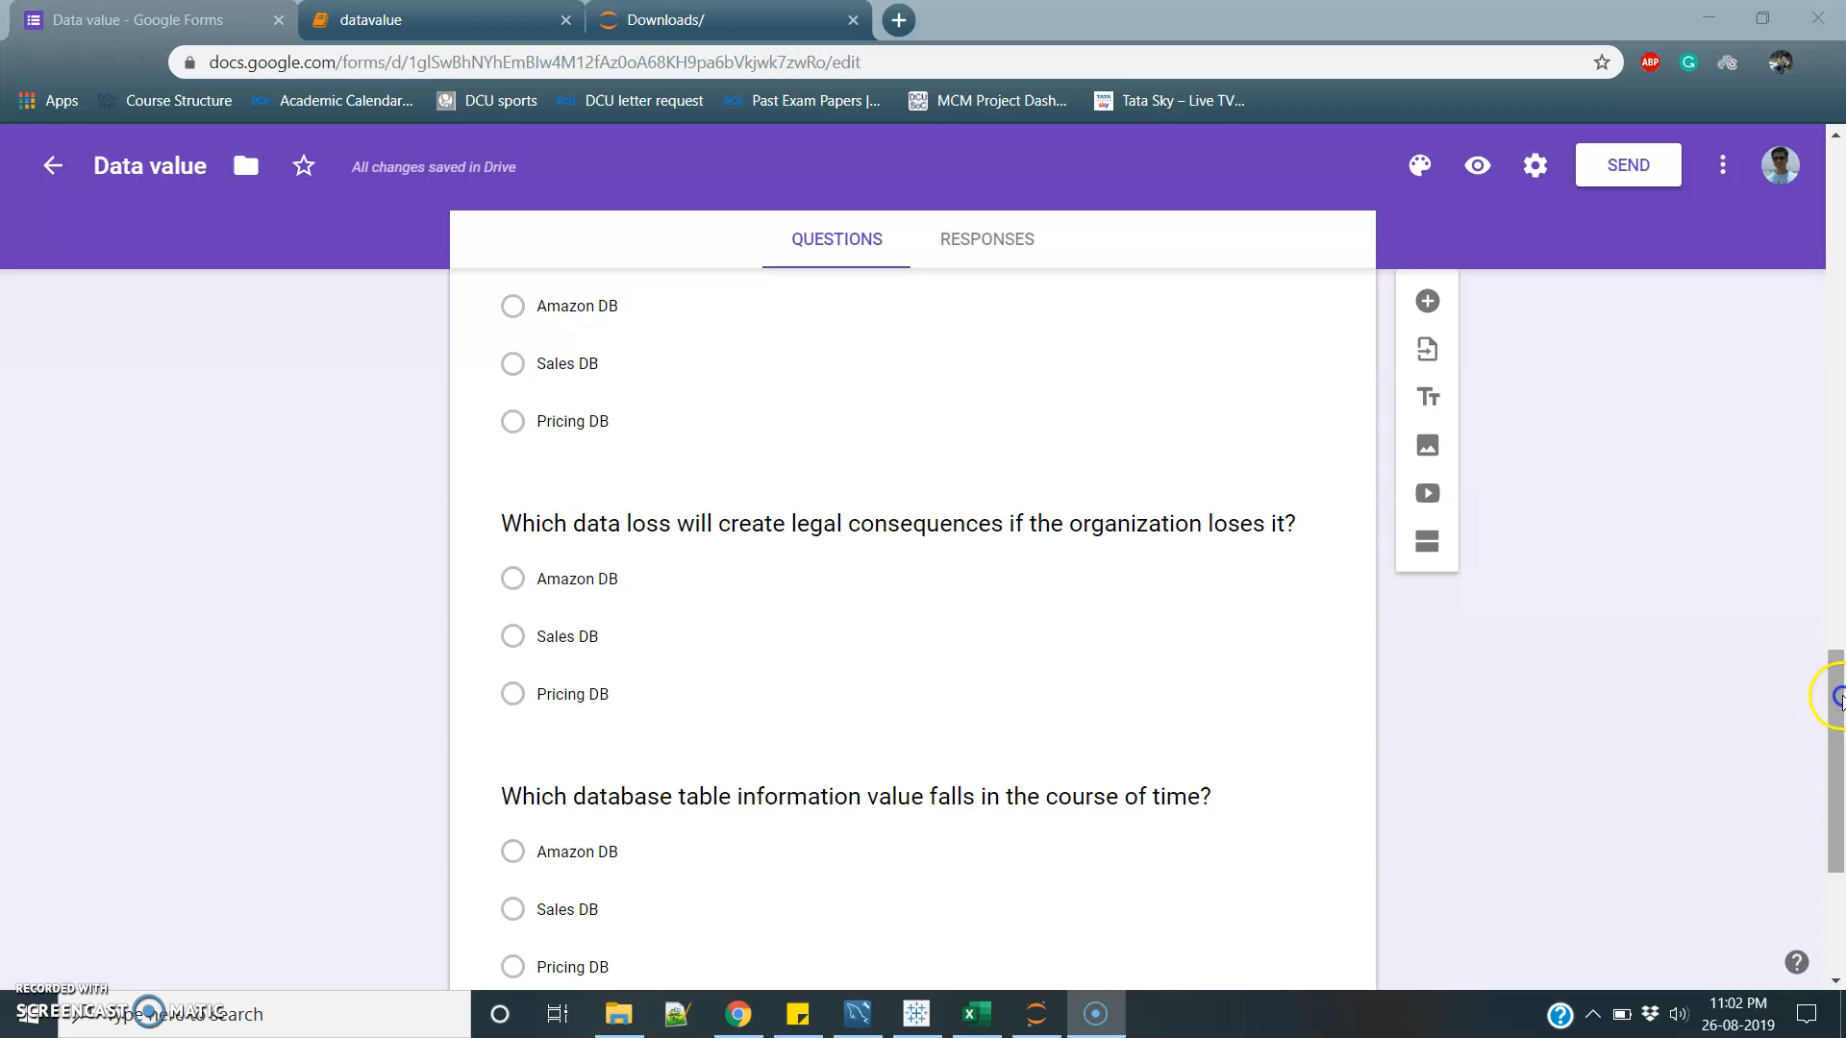
Experiment Analysis
1. Hypothesis
Whether the metrics selected can identify most valuable data for organization?”
2. Demo

Slide 13
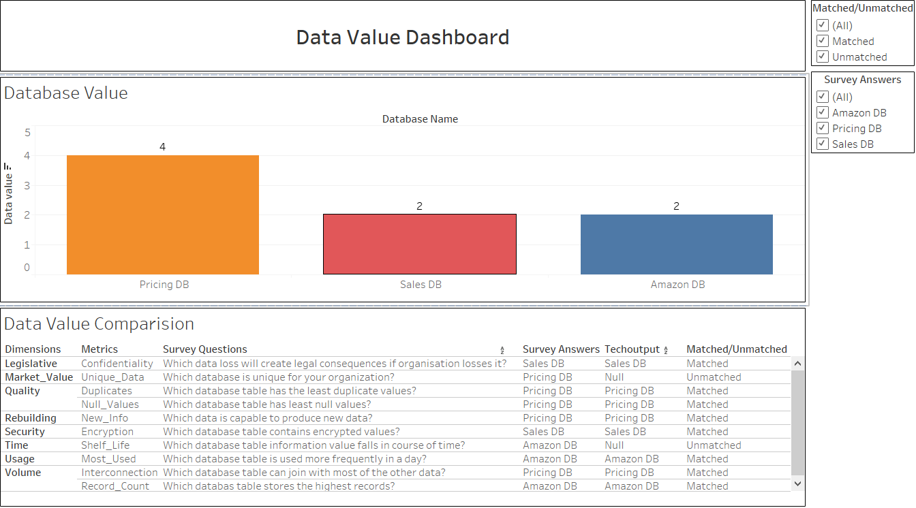
Result Analysis
Fig 4. DV Dashboard
Notes:
2 Unmatched and 8 Matched entities.
4 points got for Pricing hence it is most valuable data.

Slide 14
Conclusion
As per my knowledge the first work on data value metrics for Relational data base.
Predicted same relatives values compare to domain expert survey approach
Metrics of Dimensions like Rebuilding, Security, Volume, Usage, Quality, and Legislative were successful
However metrics of dimensions like Time, Market value unable to find data value due to
1. Limited dataset
2. Limited domain experts were available
3/5 predefined metrics and all 3 tailored metrics were successful
Data value of a relational database (RDB) data source accurately measured for a given use case of MyVolts
Notes:
Why single case study? Less research available hence only one case study.

Slide 15
Learning & Contribution
Understood the business process of MyVolts and learned how data flows within the organization
Appended three state of art dimensions in the data value analytics research
Designed a new tool which works with relational database(RDB)
Designed a system which will benefit in the data management process.

Slide 16
Future Enhancements
Use the data value tool with other databases
Use of more dimensions
Deployment on cloud environment
Notes:
Can be used with NoSQL, Data warehouse etc.
Only 8 Dimensions and 5 Metrics used so if I can add more good results.
Can be used by more people.

Slide 17
References
[1] Even, Adir & Shankaranarayanan, Ganesan. (2005). Value-Driven Data Quality Assessment.
[2] Sajko, Mario & Rabuzin, Kornelije & Bača, Miroslav. (2006). How to calculate information value for effective security risk assessment. Journal of Information and Organizational Sciences. 30.
[3] Attard, J. and Brennan, R. (2018). Challenges in Value-Driven Data Governance.
[4] Moody, Daniel, and Peter Walsh. “Measuring The Value Of Information: An Asset Valuation Approach.” Seventh European Conference on Information Systems (ECIS’99) (1999): 1–17. Web. 12 July 2017.
[5] Chen, Ying. “Information Valuation for Information Lifecycle Management.” Second International Conference on Autonomic Computing (ICAC’05). N.p., 2005. 135–146. Web.
[6] al-Saffar, S, and G L Heileman. “Semantics-Based Information Valuation.” 2008 4th International IEEE Conference Intelligent Systems. Vol. 1. N.p., 2008. 6–58. Web.
[7] Wijnhoven, Fons, Chintan Amrit, and Pim Dietz. “Value-Based File Retention.” Journal of Data and Information Quality 4.4 (2014): 1–17. Web. 12 July 2017.
[8] Tuemmler, B. (2019, 05 23). The Impact of Information Governance on Cybersecurity. Retrieved from www.nuix.com:https://www.nuix.com/blog/impact-information-governance-cybersecurityhttps://www.nuix.com/blog/impact-information-governance-cybersecurity
[9] Rob Brennan, Judie Attard, and Markus Helfurt, Management of Data Value Chains, a Value Monitoring Capability Maturity Model, 20th International Conference on Enterprise Information Systems (ICEIS), Portugal, 21-24 March 2018, Olivier Camp, Joaquim Filipe, 2018. http://www.tara.tcd.ie/handle/2262/82277

